Slide 1
Ethereum User Activity: Beyond DAU
Understanding engagement, retention, and value using on-chain data
By Sasha Meerovich

Slide 2
How Do New vs Returning Users Behave on Ethereum Over Time?
Understanding engagement, retention, and value beyond DAU
On-chain activity analysis using Ethereum transaction data
The Analysis specifies on:
DAU is widely used but often misleading
Not all active users contribute equally
This analysis combines activity, composition, and value metrics
Notes:
“I wanted to understand not just how many users are active, but who they are and how valuable their activity actually is.”

Slide 3
Key Concepts
User: A unique wallet address
Activity: On-chain transactions recorded on Ethereum
DAU: Unique wallets performing at least one transaction per day
New users: Wallets interacting on-chain for the first time
Returning users: Wallets that were active in the past and returned

Slide 4
This analysis focuses on:
Daily Active Users (DAU)
New vs Returning Users
Median value per active wallet
The impact of whale activity on averages

Slide 5
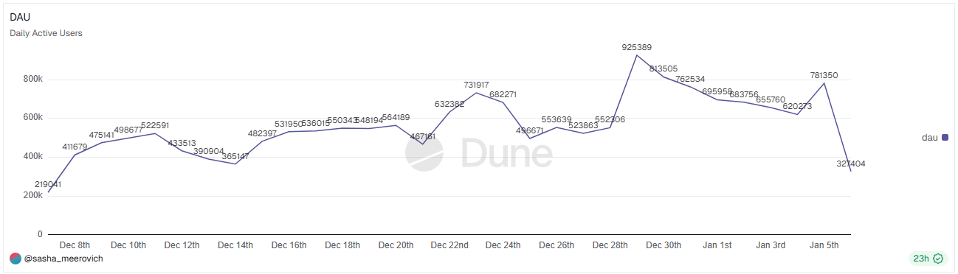
Daily Active Users (DAU)

Slide 6
Daily Active Users (DAU)
Key bullets
DAU measures how many users are active
It does not explain:
How much activity users perform
Whether users are new or retained
Whether activity is economically meaningful
Notes:
DAU can stay flat even if users are churning or doing minimal activity

Slide 7
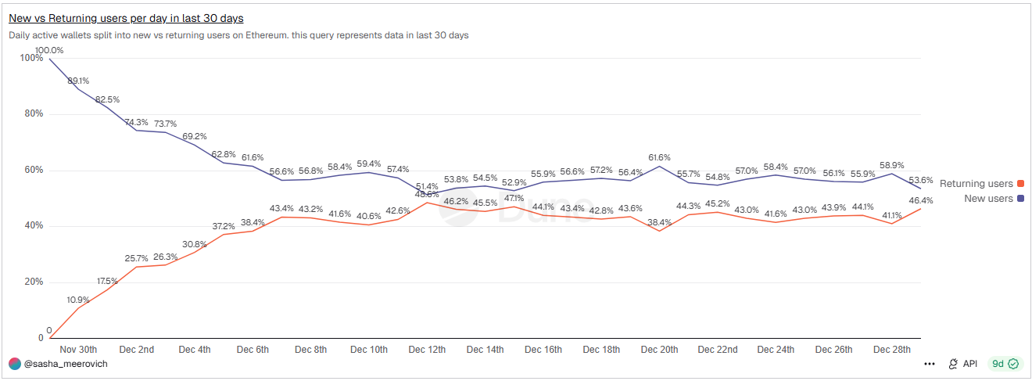
New vs Returning Users (Who drives DAU)

Slide 8
Who Are the Active Users?
Key bullets
Splits DAU into new and returning wallets
Reveals whether activity comes from:
  Retention
  One-time onboarding
Same DAU can represent very different behaviors
Changes in DAU can be driven by either retention or constant onboarding, which have very different implications for network sustainability.
Notes:
This explains why DAU changes — not just that it changes.

Slide 9
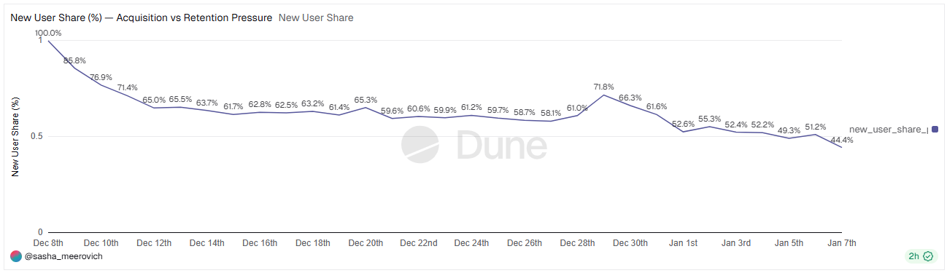
New User Share (Acquisition vs Retention Pressure)

Slide 10
Acquisition vs Retention Pressure
Key bullets
New User Share = New users / DAU
High share → acquisition-driven activity
Low share → retention-driven activity
Notes:
This metric shows whether growth is sustainable or requires constant new users.

Slide 11
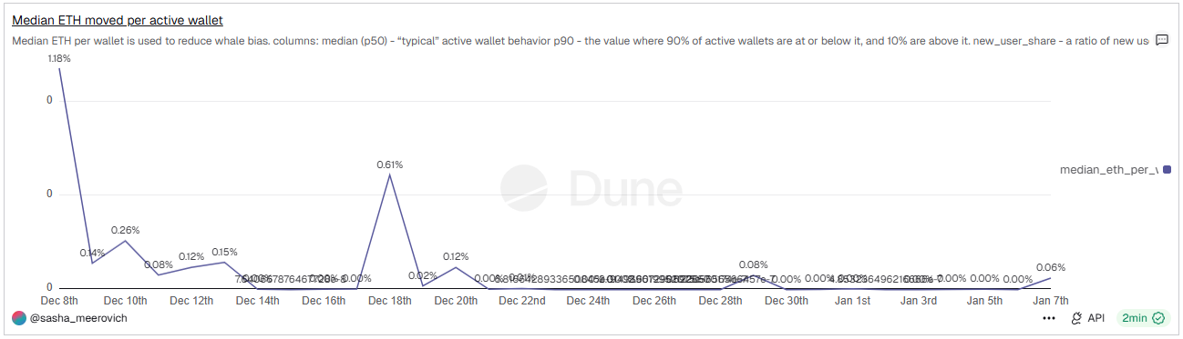
Median ETH per Active Wallet (Value)

Slide 12
How Valuable Is Typical User Activity?
Why median ETH moved per active wallet?
Average values are dominated by a small number of whale wallets
Median (p50) reflects typical user behavior
This helps distinguish:
  Broad-based engagement
  Value concentrated among few participants
Notes:
Average ETH moved is dominated by whales; median shows what most users actually do.

Slide 13
Key Takeaways
DAU alone overstates user engagement
User composition explains DAU dynamics
Acquisition-driven activity differs from retention-driven activity
Median-based metrics better represent typical user value
Meaningful engagement analysis requires multiple complementary metrics
Together, these metrics provide a more realistic picture of network engagement than any single headline metric.
Notes:
No single metric tells the full story — combining them does.

